Slide 1
Speech Emotion Recognition
Data Science Final Project
Bach, Kien, Sauryanshu and Sike

Slide 2
LAYOUT
Dataset
Exploring and Augmenting the Data
Feature Extraction
Baseline Models
More Advanced Models
Comparison of the Models
Model Evaluation

Slide 3
PROBLEM STATEMENT
Can we predict human emotion in speech?

Slide 4
DATA

Slide 5
DATA
1440 individual audio files = 1440 observations
Spread evenly among 24 Voice actors, with 60 trials per actor.
Gender balanced and Lexically matched statements.
Either of the two statements:
•Dogs are sitting by the door
•Kids are talking by the door

Slide 6
FEATURES
•All individual audio files had 7 features:
•Modality: AV or Audio Only
•Vocal Chanel: Speech/ Song
•Emotion: Neutral, Calm, Happy, Sad, Angry, Fearful, Disgust, Surprised
•Emotional intensity: Normal, Strong
•Statement: Kids are…, Dogs are…
•Repetition: 1st Repetition, or 2nd Repetition
•Actor: Male or Female
•Emotion: Label
•All of these could be our labels. Why? Because we use a Neural Network
• Using a Neural network means that majority of our features are rendered irrelevant.

Slide 7

Samples
Anger
Fear
Happy
Sad

Slide 8
Data Augmentation
Objectives: Prevent overfitting, increase training set, increase test accuracy

Slide 9
Examples of Augmentation techniques
Stretching
Pitch
Shifting

Slide 10
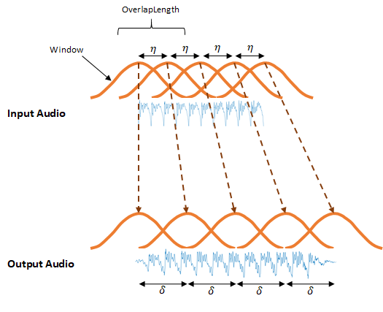
Stretching
Stretch time
Frequency modulated by a constant factor
determined by time stretch
Maintain proportionality between amplitudes

Slide 11
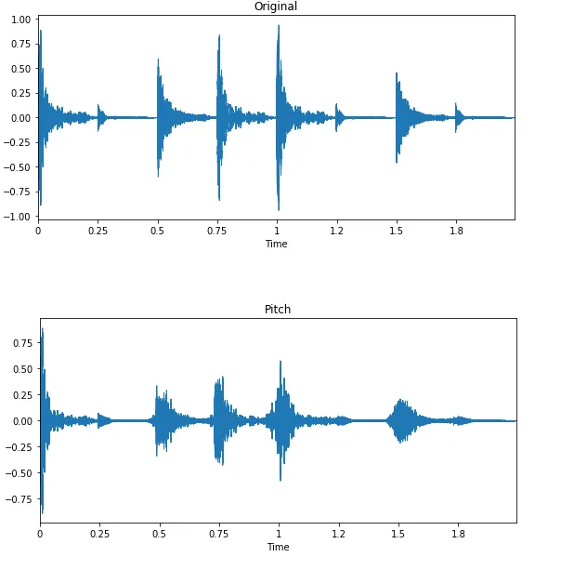
Pitch
Two types of pitch Shifts:
Time and Frequency
We use Frequency
Change frequency randomly

Slide 12
Augmented Audio Samples
Shifting
Stretching
Pitch
Noise Injection

Slide 13
Feature Extraction
What sort of audio features can we extract from the audio file?

Slide 14
Feature Extraction
Remember! We’re using a neural network. Since we don’t specify form of the model in a NN, we only provide features for it to train on.
Several possibilities:
Mel Frequency Cepstral Coefficients (MFCC)
Zero Crossing Rate
Chroma Features

Slide 15
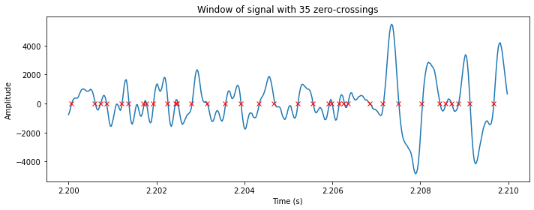
Zero Crossing Rate
Notes the number of times
The discrete audio values
change signs (+ to - and vice
versa)
Not particularly useful for
speech recognition

Slide 16
Chroma Features
A broad range of specific features fall within Chroma Features, such as Chroma Vector, Chroma Stft
All of them focus on pitch-level changes in the audio Data

Slide 17
Mel Frequency Cepstral Coefficients
Extraction of MFCCs are quite math-heavy, and complex
But in essence, they extract all essential elements of an audio:
Frequency changes, amplitude changes, et cetera.
Highly capable for Voice recognition Models
We tried other features, but given MFCC’s performance, we chose to use MFCCs as a feature.

Slide 18
Data Exploration
What do our audio files look like?

Slide 19
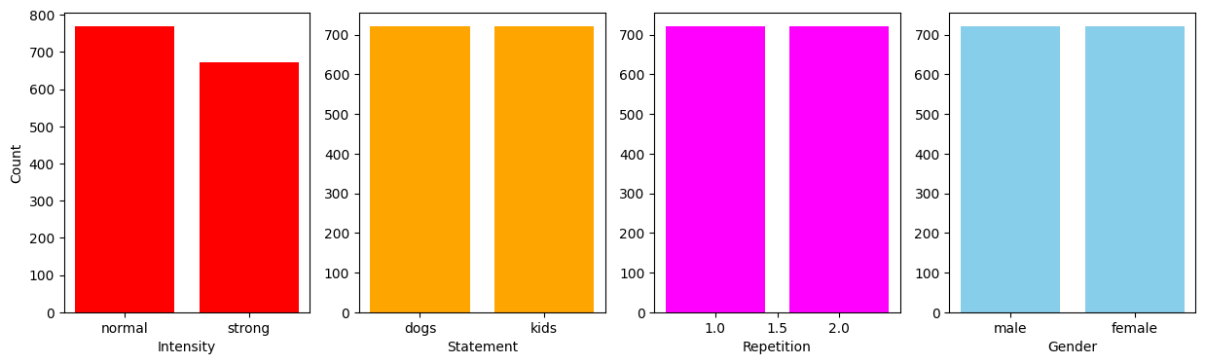
Generally well-balanced across attributes!

Slide 20
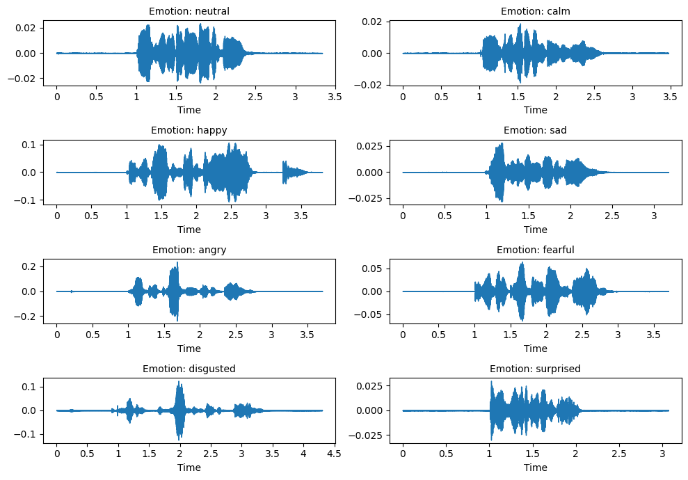
Extracting MFCC from these audio files
Spectrograms show enough variability amongst target labels on Amplitude, Frequency, duration, and changes within them.
If no variability amongst them, NN would be useless

Slide 21
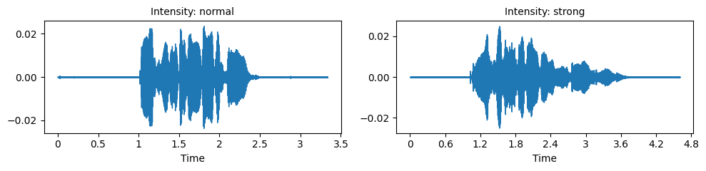
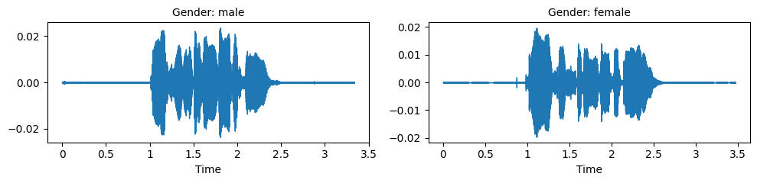
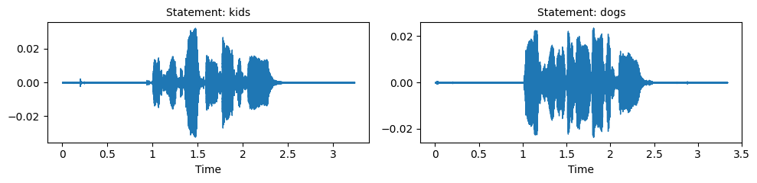
More Examples from across our non-label features

Slide 22
MODELS

Slide 23
Baseline Models
K Nearest Neighbours
Multilayer Perceptron
Convolutional Neural Network
Notes:
making them excellent starting points for benchmarking and improving more advanced models

Slide 24
K Nearest Neighbours
Cross-validation was performed on different k values using ten splits
k = 1 makes for the best number of neighbors, as F1 steeply drops as k increases
Achieved an accuracy of 55%
Notes:
which is considerably better than we would expect for say, a random classifier (that is ⅛ or 12.5%).
Simplicity and Interpretability: kNN is a non-parametric, instance-based learning algorithm that is simple to implement and easy to understand
No Training Phase: kNN does not require a training phase, and the classification is done by a majority vote of the nearest neighbors. This can be particularly useful in speech emotion recognition where the emotional characteristics can sometimes be distinctly separated in the feature space.
Contextualizing More Complex Models:
Benchmarking: kNN can serve as a baseline for performance metrics. If a more complex model cannot outperform kNN, it may indicate that the additional complexity is not capturing useful patterns in the data.
Feature Effectiveness: The performance of kNN heavily relies on the choice of features and distance metrics. Observing what works well with kNN can provide insights into which features might be effective when designing more sophisticated models.

Slide 25
Multilayer Perceptron
Capable of learning non-linear relationships, which is critical in handling the complexities of human speech
Includes hidden layers, allowing it to learn a hierarchy of features
Our model had 14 hidden layers and 131,688 trainable parameters, and achieved an accuracy of 56%.
Notes:
Our first neural network was a fully-connected, feed-forward one. MLPs are good at capturing interactions between features at a global level. They are also versatile and adaptable, and we thought their ability to solve our problem was worth exploring.
Why It’s Suitable:
Flexibility: MLPs are capable of learning non-linear relationships, which is critical in handling the complexities of human speech that involve varying tones, intensities, and speeds.
Hidden Layers: The architecture includes one or more hidden layers, allowing it to learn a hierarchy of features, which can be more expressive compared to models without hidden layers.
Contextualizing More Complex Models:
Understanding Layer and Neuron Dynamics: By experimenting with different architectures in MLPs, we can gain insights into how deep the model needs to be and how many neurons are required per layer for effective learning.

Slide 26
Convolutional Neural Network
Highly effective at recognizing patterns in spatial data. In speech recognition, converting audio into spectrograms transforms the problem into a 2D image recognition task
Can automatically learn necessary features of raw data
Our model has 18 hidden layers and 110,216 trainable parameters, achieving an accuracy of 45%
Notes:
Why It’s Suitable:
Local Pattern Recognition: CNNs are highly effective at recognizing patterns in spatial data. In speech recognition, converting audio into spectrograms transforms the problem into a 2D image recognition task, where CNNs can detect local patterns like specific sound frequencies occurring at certain times.
Automatic Feature Engineering: Unlike traditional methods that require manual feature extraction, CNNs can automatically learn the necessary features from raw data.
Contextualizing More Complex Models:
Benchmark for Automatic Feature Learning: The performance of CNNs can help determine whether automatically learned features from raw data or pre-processed forms (like spectrograms) are more effective than manually engineered features.

Slide 27
Advanced Models
Long-Short Term Memory Network
CNN + LSTM Network
Bi-directional LSTM Network
Notes:
3 models in total
1st one
2nd one: CNN combined with LSTM
3rd one

Slide 28
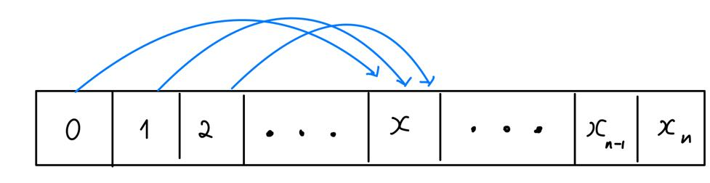
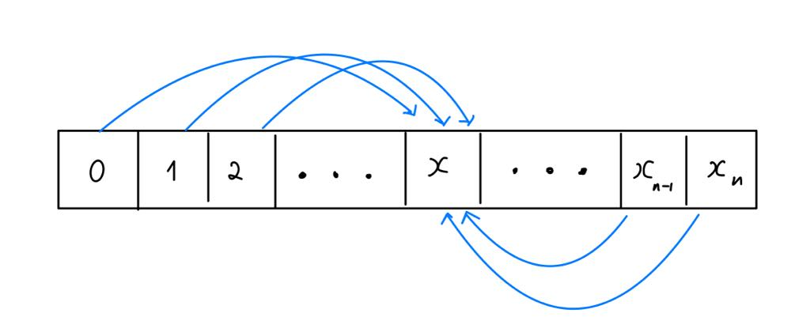
Advanced Models - Long-Short Term Memory Layer
LSTM: Effective in remembering important information from earlier parts of the sequence and use it to process later parts.
Bi-Directional LSTM: not only it can learn from the earlier parts of the data, but also the later parts.
LSTM
Bi-Directional LSTM
Notes:
An LSTM layer is a special type of layer in recurrent neural networks that excels at understanding time-series data.
LSTMs can remember important information from earlier parts of the sequence and use it to process later parts.
LSTM is ideal for time series data such as speech recognition, and analyzing time series data. Bi-D LSTM - an extension of traditional LSTMs that can improve model performance on sequence classification problems.
Instead of 1 LSTM, it use 2 LSTM layers.
1 LSTM reads the data forward, while the other reads it backward.
This allows the Bi-D LSTM to understand the context of each part of the sequence by considering both what comes before and after it, leading to more accurate predictions.
Here you also find a rough image description of the LSTM layers.
LSTM only feed with the earlier data, while Bi-D LSTM is feed with the later data as well.

Slide 29
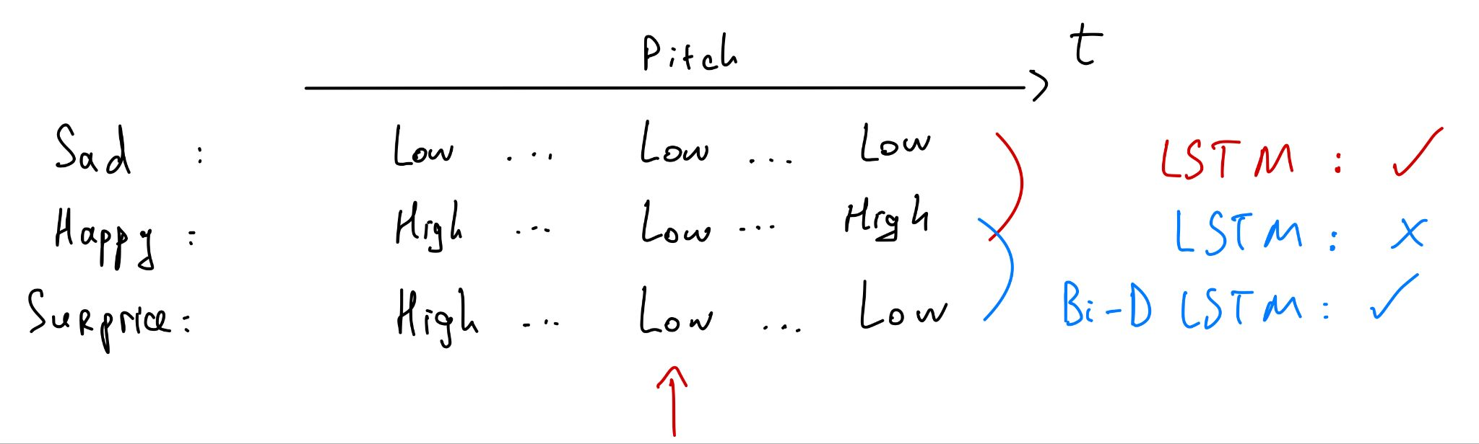
Advanced Models - Long-Short Term Memory Layer
Notes:
Look deeper with a rough example
Left to right is time order
The value is voice pitch
The value here is totally made up by me
Evaluate at the middle point by the red arrow
Sad - happy - surprise
As you can see
Sad vs Happy: lstm works
Happy vs Surprise: basic lstm would have a trouble differentiate, but Bi-D LSTM still can works

Slide 30
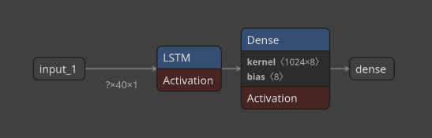
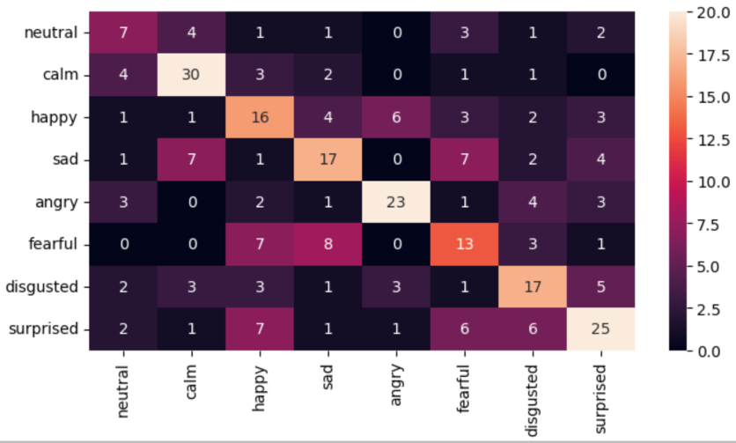
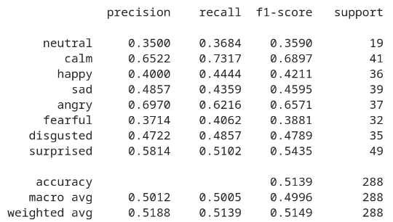
Advanced Models - LSTM Network
Model architecture: 1 layer of LSTM
Parameters: 5,393,944
Time to train: 2 minutes
Notes:
The time is measured on the same GPU.
Confusion matrix: performance is all over the place.
Classification report: it is also not good either with only 50% accuracy.

Slide 31
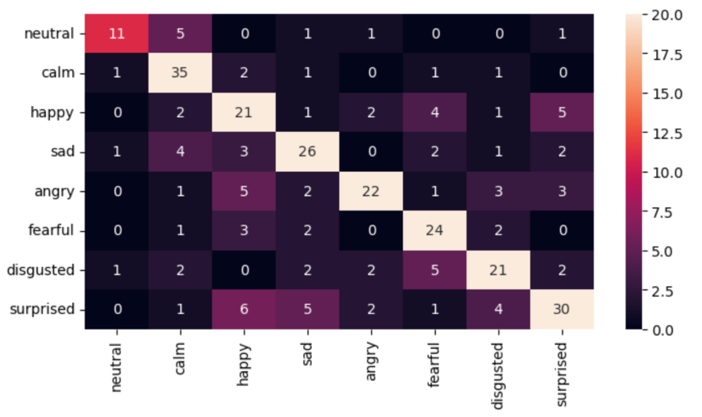
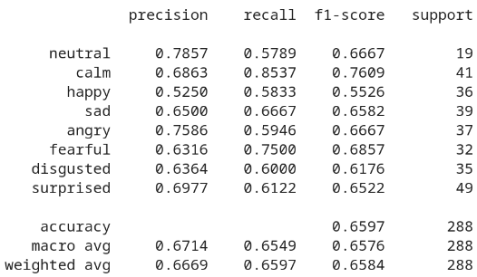
Advanced Models - CNN + LSTM Network
Model architecture: Conv1D -> LSTM
Parameters: 4,210,696
Time to train: 1.5 minutes
Notes:
The main idea here is to use Conv1 layers to detect pattern in the time series. Use that pattern output to train LSTM layer.
Confusion matrix: the performance is much better now.
However, it is still not perfect.
For example, it still occasionally confuse happy with sad, angry, and surprise.
Classification report: much better, we go from 50% to 65%.

Slide 32
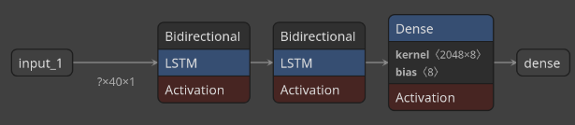
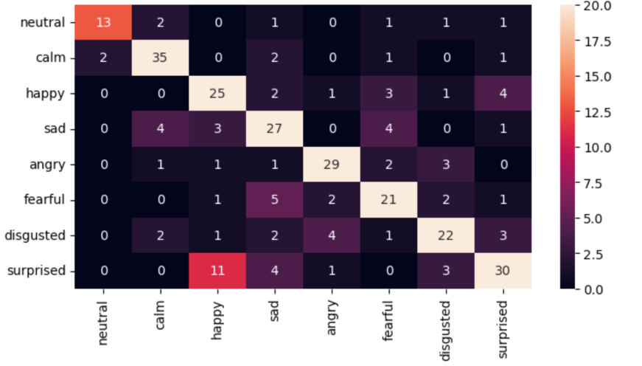
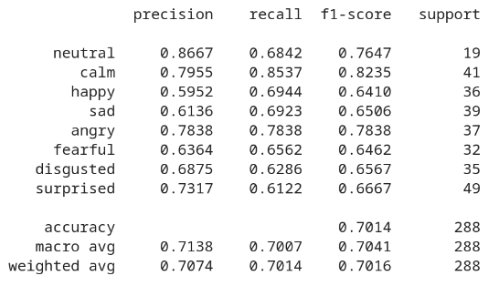
Advanced Models - Bi-directional LSTM Network
Model architecture: 2 layer of Bi-Directional LSTM
Parameters: 33,595,400
Time to train: 13 minutes
Notes:
Confusion matrix: the performance is even better.
Nevertheless, it still occasionally confuse happy with surprise but not with sad and angry as much as combined model.
Classification report: much better, we go from 50% to 65% to 70%.

Slide 33
EVALUATION

Slide 34
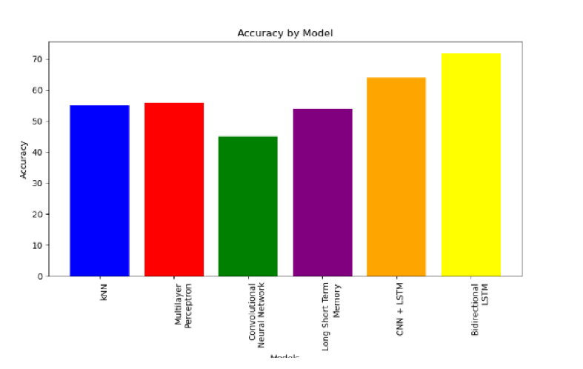
Model Comparison
Notes:
These are how the models performed in relation to one another, based on their accuracies.
Note that, for all our models, the accuracy, precision, F1 and recall scores were all really
close in value, so if we had made this plot on F1 scores instead of accuracy, it will look pretty much the same.
As Bach said, the bi-directional LSTM does the best, considerably.
And the CNN turned out to be the worst model, even up to the point that the humble kNN outperforms it.
And remember, the kNN is a lazy model, which memorises and does not learn. So this was surprising.

Slide 35
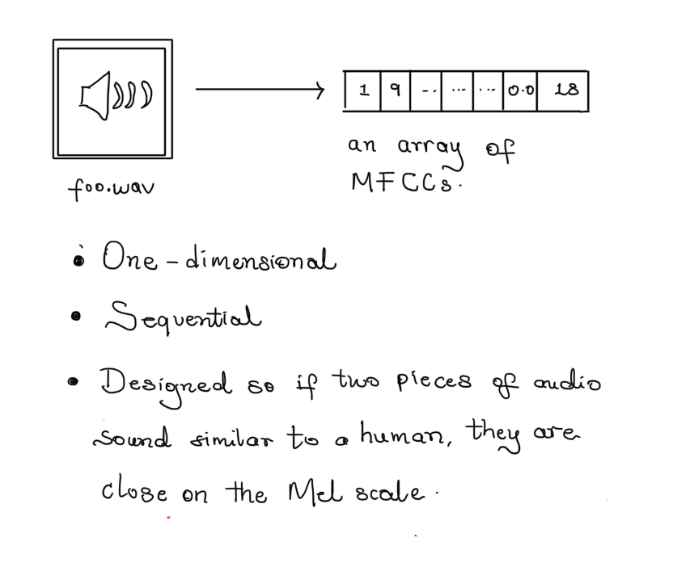
Why?
Notes:
But we think the behavior was as a result of the fact that we trained them on MFCCs.
The nature and purpose of it.
An array of MFCCs we have extracted from a piece audio of audio is sequential, in relation to the audio.
Having similar MFCCs meaning they sound the same means that the euclidean distance between audio files in this project is especially meaningful,
allowing our kNN to perform decently even though it is lazy.

Slide 36
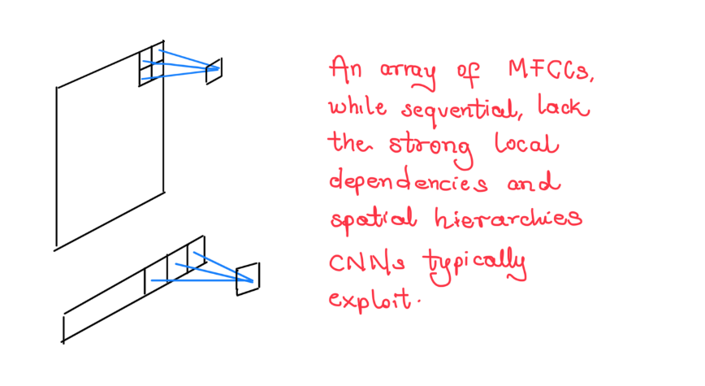
CNN Performance
Worse than kNN, worse than MLP.
Notes:
As for CNNs, maybe this was not just a problem where CNN’s could shine, especially not on their own.
Again, because of the final nature of our training data. An array of numbers, even sequential ones, just do not have the
spatial properties that let CNNs succeed. And we think that was why they had the poorest performance.

Slide 37
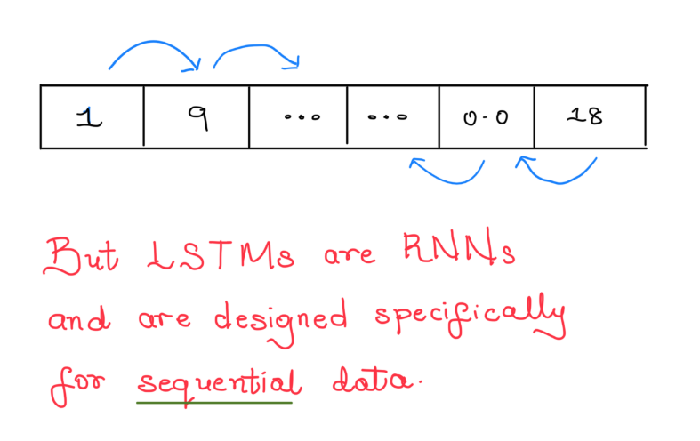
LSTM Performance
The best.
Notes:
LSTMs, on the other hand, are designed for sequential data.
MFCCs are coefficients. In our array, they have a sequential relationship, but it is not
necessarily a left to right one. So a bi-directional LSTM that combine L to R and R to L
Probably had a broader context to work with

Slide 38
What emotion was easiest to recognise?
Happy
Sad
Angry
Fearful
Calm
Neutral
Surprised
Disgusted
Notes:
What do you think was the easiest and hardest emotions for our LSTM models to recognise

Slide 39
What emotion was easiest to recognise?
Happy
Sad
Angry
Fearful
Calm
Neutral
Surprised
Disgusted
87.89% accuracy
57.14% accuracy
Notes:
It was prone to misclassify disgusted as angry, and I guess that makes sense
We don’t know why, but we know it was not a class imbalance problem.
Neutral was 78.9, and that had only half the number of samples as the rest
This was from the LSTM model but all the models did tend to classify calm much better than disgust, so it is not a necessarily specific problem.

Slide 40
Project hosted at:
https://github.com/sauryanshu55/Speech-Recognition/

